Slide 1

AI Cyber Threat Detection: Protecting Against Evolving Threats
The cyber threat landscape is rapidly evolving. Traditional security systems are struggling to keep pace. AI-driven solutions offer enhanced detection capabilities. This presentation explores AI's role in modern cybersecurity.
A Presentation by:
Aryan Pillai - 24BCE5492
Sravan Kowsik Gonuguntla - 23BRS1383
Shreeja Karajagi - 24BRS1349
Vishnu Managoli - 23BAI1437

Slide 2
Problem Statement
Statement: AI Cyber Threat Detection
Context: Cybercriminals use sophisticated techniques that bypass traditional security making real-time threat detection critical.
Challenge: Create an AI system that analyzes network activity and user behavior to identify and prevent cyber threats.

Slide 3
Problem: Traditional Methods Fall Short
Limitations
Example: WannaCry
Signature-based detection is vulnerable to new threats.
The 2017 WannaCry ransomware exploited a zero-day vulnerability. This attack caused billions in damages. Traditional systems were unable to prevent it.
Heuristics generate high false positive rates.
Manual analysis is slow and costly.
Traditional methods struggle to scale.

Slide 4




Solution: AI-Powered Anomaly Detection
Machine Learning
Isolation Forest
Leverage machine learning to identify deviations from normal behavior.
Employ the Isolation Forest algorithm for unsupervised anomaly detection.
Unseen Threats
Detect previously unseen attack patterns, improving security posture.

Slide 5




Core Components: Code Overview
Pandas
Data manipulation and analysis using dataframes.
Isolation Forest
Unsupervised anomaly detection algorithm for finding outliers.
Numpy
Numerical computing for efficient data processing.

Slide 6
Implementation using IOT
IOT devices are vulnerable breach points of a network
If these devices are not protected well, they can wreak havoc
As they have low end configurations, they need to have a highly optimised software that can ensure network security and integrity.
The IoT device should have a basic whitelist and blacklist which would be updated periodically over time using a computer on the network as a "supervisor", a device with higher processing power and the device should have basic intelligence to filter legitimate requests and compromised requests. The IoT device should also go ahead and contact the supervisor that would review a request in case the IoT device is unable to identify the request and label it.

Slide 7
Implementation using IOT
In case the IoT device gets compromised, in real time, the IoT device should get isolated from the rest of the network and the device should be quarantined promptly to ensure the integrity of the entire network. All the devices on the entire network should run an integrity check to ensure no malware has been spread. In case malware has been spread, then that segment of the network should also be quarantined. Then that segment of the network should be down, and then further action should be requested from the user to ensure the next course of action is taken promptly to get the device back online.

Slide 8




Deep Dive: Isolation Forest Implementation
Unsupervised Learning
Requires no labeled data for training.
Isolation Trees
Identifies anomalies based on path length.
Training
Trains the model on historical network traffic.

Slide 9




Real-time Threat Analysis & Integration
FastAPI
Builds a real-time API for threat detection.
Asyncio & Threading
Enables parallel processing for high throughput.
Logging
Maintains detailed logs for auditing and debugging.

Slide 10
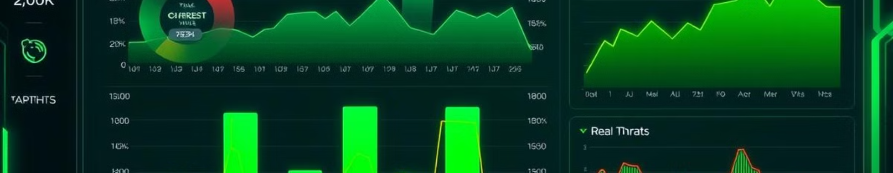
Visualization and User Interface (PyQt5)
GUI
Embedding
Customizable Dashboards
Build a GUI for visualizing threat data with PyQt5.
Embed visualizations within the GUI using Matplotlib.
Create dashboards for monitoring key metrics.

Slide 11




Conclusion: The Future of Cybersecurity is AI
Improvement
AI-driven threat detection significantly improves on traditional methods.
Foundation
This code provides a foundation for a real-time security solution.
Future
Incorporate sophisticated AI algorithms and improve UI scaling.

